Slide 2
Note: Any videos in this presentation will only play online. After you download the slideshow, you will need to also download the videos from YouTube & add them back into your PowerPoint.
We present these messages at Bee Creek Park in College Station, TX. If you would like to watch the video of the service with this message, click here:
http://campaignkerusso.org/?p=11078
We would love to know more about the people who download our lessons & sermons. We invite you to email us & let us know where & how you use them.
info@ckbrazos.org

Slide 3
Next Slide: Song – Draw Me Into Your Presence Download Here: http://youtu.be/FWsuQGVHvek

Slide 5
He draws when we draw. We pull once and He pulls twice. We pull again and He pulls 3x, etc.

Slide 6
Jesus Wants Us Close to His Heart

Slide 7
How Close Are We?

Slide 8
Some are Far Away & Some are in His Inner Circle – Friends

Slide 9
Religious leaders - and many others didn’t want Him at all

Slide 10
Others Only Wanted to See Miracles
“Some Jews said to Jesus, “Show us a miracle as a sign from God…” John 2:18

Slide 11
Still Others Only Wanted the Free Food
Jesus replied, "I tell you the truth, you want to be with me because I fed you… John 6:26

Slide 12
Some (like the rich young ruler) thought they wanted to follow Jesus
…but wouldn’t go all the way

Slide 13
There were 12 disciples who followed Him everywhere!

Slide 14
And three (called, the inner circle) who followed him most closely → Peter, James & John

Slide 15
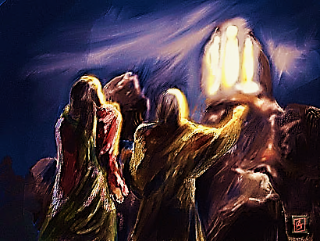
When He raised the little girl from death. Mark 5:37
When He glowed on a mountaintop.
Mark 9:2
When He gave private lessons and Q & A. Mark 13:3
When He prayed in the Garden.
Mat. 26:37

Slide 16
12 disciples followed till it became very unpopular to be a follower of Jesus.
Then Judas betrayed Him, Peter denied Him, and most of the rest just ran & hid out.

Slide 17
But, John was Closest to Jesus.
John leaned on His chest and listened to His heart
John was the only one at the cross and was the first of the twelve at the empty tomb

Slide 18
But, John was Closest to Jesus
Jesus asked him to care for Jesus’ mother after He was gone
He was Jesus’ “BFF”
(Best Friend Forever)

Slide 19
He Calls us to be Near Him
“All day long I have held out my hands…” Rom. 10:21

Slide 20
“The Lord is near to all who call on him, to all who call on him in truth.” Ps. 145:18

Slide 21
Next Slide - Video: What is a Relationship With God? Download Here: http://www.youtube.com/watch?v=Hsy-0-X7nkU

Slide 22
Next Slide - Video: Draw Me Into Your Presence Download Here: http://youtu.be/FWsuQGVHvek

Slide 23
Is Jesus Speaking to You?
“They said to each other, ‘Did not our hearts burn within us while he talked to us on the road, while he opened to us the Scriptures?’”
John Wesley Said:
“…the preacher was describing the change which God works in the heart through faith in Christ and I felt my heart strangely warmed.”
Jesus makes His presence Known by a small voice!

Slide 25
What is the Sinner‘s Prayer?
This is a prayer we can pray when we are ready to admit we are sinners and need Christ’s forgiveness.
It must be prayed with faith in our hearts and a readiness to have a life-changing encounter with Jesus Christ.

Slide 26
A prayer of faith → Pray this prayer if :
If you never have before
You have in the past, but you think it would mean more today
You have been walking afar off and you want to come back
You want to set an example & show others how it is done
You just like to give your heart to Jesus again & again
Faith

Slide 27
We Declare Our Faith Publicly Because Jesus Declared His LOVE Publicly
“If you stand before others and are willing to say you believe in me, then I will tell my Father in heaven that you belong to me.” Mat 10:32

Slide 28
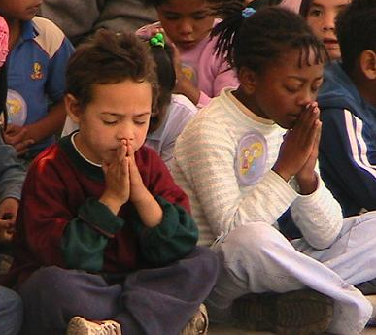
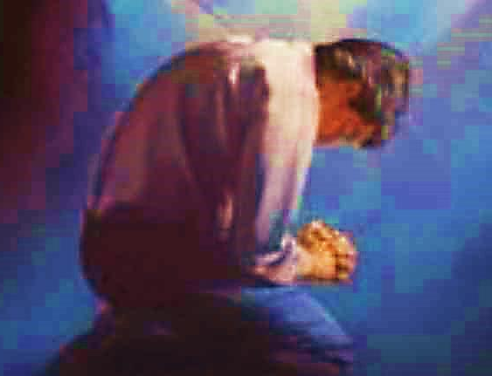
Important Questions
Do you want to know Jesus as your Savior right now?
Do you believe He died to save you from your sins & that He rose from the dead?
Do you believe that He is here, waiting to save you right now?

Slide 29
The Prayer of a Sinner Turning to Jesus
Dear Jesus, I know that I have sinned against You and that my sins separate me from You.
I am truly sorry.
Right now, I turn away from my sinful past .
Please forgive me, and help me to keep from sin.
I believe You died for my sins.
I Believe You rose from the dead, you are alive, and you hear this prayer from my heart.
I invite You Jesus to be both my Savior and the Lord of my life.
I want You to rule my life from now on.

Slide 30
“But some people did accept him. They believed in him, and he gave them the right to become children of God.”
John 1:12

Slide 32
“If you openly say, ‘Jesus is Lord’ and believe in your heart that God raised him from death, you will be saved.”
Rom. 10:9
What did you learn today?
What is the meaning of the name-tag?
What have you been thinking about God lately?
What do you want to tell the world about Jesus?

Slide 33
“Draw near to God, and He will draw near to you…
Altar Time
…Cleanse your hands, you sinners, and make your hearts pure, you who are half-hearted towards God.” James 4:8 WNT

Slide 34
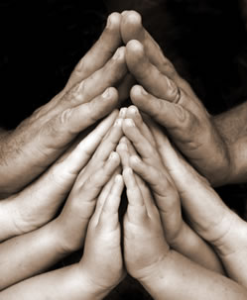
Close in Prayer

Slide 35
Note: Any videos in this presentation will only play online. After you download the slideshow, you will need to also download the videos from YouTube & add them back into your PowerPoint.
We present these messages at Bee Creek Park in College Station, TX. If you would like to watch the video of the service with this message, click here:
http://campaignkerusso.org/?p=11078
We would love to know more about the people who download our lessons & sermons. We invite you to email us & let us know where & how you use them.
info@ckbrazos.org

Slide 36
Welcome to Aggieland Faith Family Style Worship

Slide 37
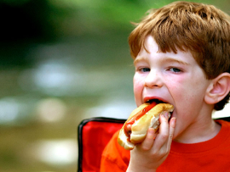
CURRENT SCHEDULE: See www.Aggielandfaith.org
SATURDAY —
At Bee Creek Park
2:00-4:00pm: Through the bible with felt-board stories – plus hot-dogs & drinks
SUNDAY —
At Bee Creek Park
2:00-4pm: Free snacks, drinks, kids crafts, prizes, singing & bible preaching

Slide 38
Would You Like Prayer or Bible Study at Your House?
Personal Prayer: We can come to your home & pray with you, or you can email us when you need prayer.
Home Bible Study: We will come to your home & hold a bible study for you & your friends.
Bible Party: We will hold a Kid’s Bible Party: You provide the food & kids - we will do the bible fun & stories.

Slide 39
Would You Like Visitation?
We will visit a friend, loved one in the hospital or in prison to pray for them & share Christ with them.
Contact: info@aggielandfaith.org

Slide 40
www.aggielandfaith.org
Go here to see pictures & videos
Go here to subscribe to e-mails about changes & cancellations

Slide 41
Note: Any videos in this presentation will only play online. After you download the slideshow, you will need to also download the videos from YouTube & add them back into your PowerPoint.
We present these messages at Bee Creek Park in College Station, TX. If you would like to watch the video of the service with this message, click here:
http://campaignkerusso.org/?p=11078
We would love to know more about the people who download our lessons & sermons. We invite you to email us & let us know where & how you use them.
info@ckbrazos.org

